Slide 1
Excel Project Coffee shop Dashboard

Slide 2
Objective
The main object of this project is to analyze retail sales data to gain actionable insights that will enhance the performance of the coffee shop

Slide 3
Recommendation analysis
How do sales vary by day of the week and hour of the day?
Are there any peak times for sales activity?
What is the total sales revenue for each month?
How do sales wear across different store locations?
What is the average price for order Per person?
Which products are the best selling in terms of quantity and revenue?
How do sales vary by Product category?

Slide 4
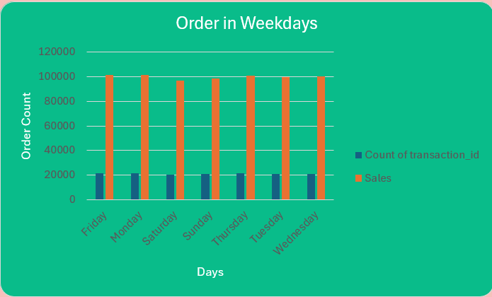
by day of the week?
How do sales vary

Slide 5
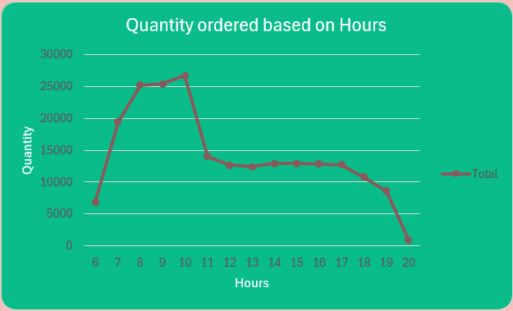
How do sales vary
by hour of the day?

Slide 6
Peak times for sales activity
10 AM is the Peak time for Sales according to the Data

Slide 7
Total sales revenue for each month
10 AM is the Peak time for Sales according to the Data

Slide 8
Selecting visual aids
Enhancing your presentation

Slide 9
Effective delivery techniques
This is a powerful tool in public speaking. It involves varying pitch, tone, and volume to convey emotion, emphasize points, and maintain interest:
Pitch variation
Tone inflection
Volume control
Effective body language enhances your message, making it more impactful and memorable:
Meaningful eye contact
Purposeful gestures
Maintain good posture
Control your expressions

Slide 10
Navigating Q&A sessions
Know your material in advance
Anticipate common questions
Rehearse your responses
Maintaining composure during the Q&A session is essential for projecting confidence and authority. Consider the following tips for staying composed:
Stay calm
Actively listen
Pause and reflect
Maintain eye contact

Slide 11

Speaking impact
Your ability to communicate effectively will leave a lasting impact on your audience
Effectively communicating involves not only delivering a message but also resonating with the experiences, values, and emotions of those listening

Slide 12
Dynamic delivery
Learn to infuse energy into your delivery to leave a lasting impression.
One of the goals of effective communication is to motivate your audience.
Metric | Measurement | Target | Actual
Audience attendance | # of attendees | 150 | 120
Engagement duration | Minutes | 60 | 75
Q&A interaction | # of questions | 10 | 15
Positive feedback | Percentage (%) | 90 | 95
Rate of information retention | Percentage (%) | 80 | 85

Slide 13
Final tips & takeaways
Consistent rehearsal
Strengthen your familiarity
Refine delivery style
Pacing, tone, and emphasis
Timing and transitions
Aim for seamless, professional delivery
Practice audience
Enlist colleagues to listen & provide feedback
Seek feedback
Reflect on performance
Explore new techniques
Set personal goals
Iterate and adapt

Slide 14
Speaking engagement metrics
Impact factor | Measurement | Target | Achieved
Audience interaction | Percentage (%) | 85 | 88
Knowledge retention | Percentage (%) | 75 | 80
Post-presentation surveys | Average rating | 4.2 | 4.5
Referral rate | Percentage (%) | 10 | 12
Collaboration opportunities | # of opportunities | 8 | 10

Slide 15
Thank you
Brita Tamm
502-555-0152
brita@firstupconsultants.com
www.firstupconsultants.com

